Slide 1
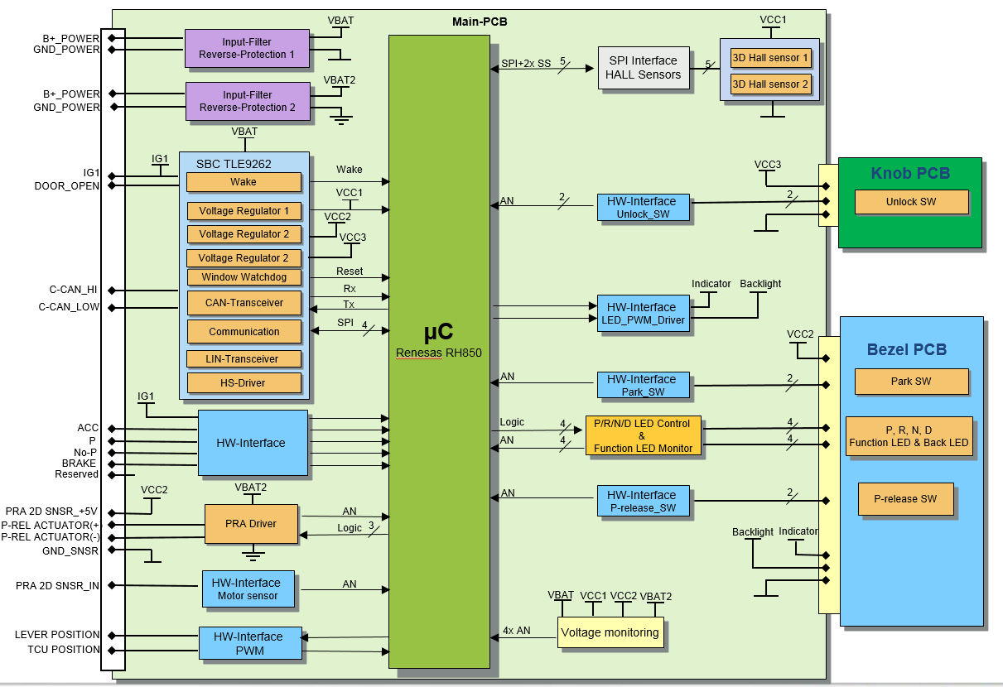
NO. | PIN NAME | Description | Remark
1 | B+_POWER | Battery+
2 | PRA 2D SNSR_+5V | PRA Sensor Power
3 | PRA 2D SNSR_IN | PRA Sensor Signal
4 | GND_SNSR | PRA Sensor Ground
5 | C-CAN_LOW | HS-CAN Low Level Signal
6 | C-CAN_HI | HS-CAN High Level Signal
7 | BRAKE | Brake State Signal | ON:B+, OFF:GND
8 | TCU POSITION | TCU Back-up Signal Input PWM | TCU -> SBW
9 | LEVER POSITION | Lever Position Back-up Signal Output PWM | SBW -> TCU
10 | GND_POWER | Ground
11 | B+_POWER | Battery+
12 | P-REL ACTULATOR(+) | PRA Power
13 | P-REL ACTULATOR(-) | PRA Power
14 | - | No Connect
15 | IG1 | Ignition1 State Input
16 | ACC | Accessory State Input
17 | P | Park State Signal (from T/M) | ON:GND,OFF : Floating
18 | Not-P | Not Park State Signal (from T/M) | ON:GND,OFF : Floating
19 | DOOR_OPEN | Door Open State Signal | Driver Side
20 | GND_POWER | Ground

Slide 2
Acronyms and Abbreviations | Description
BAT | Battery Voltage
CGW | Central Gateway
D | Driver
DTC | Diagnostic Trouble Code
E-shift Lever System | Electronic Shift Lever System
H/W | Hard Wire
HS-CAN | High Speed-Controller Area Network
HW | Hardware
N | Neutral
P | Park
PH | Physical
PRA | Park Release Actuator, change the Control Lever of T/M 'P' ↔ 'Not P'
PRC | Park Release Cable
PRD | Park Release Driver
P-Release | Park Release
R | Rear
RPM | Revolutions Per Minute
SBW | Shift By Wire
SW | Software
T/M | Transmission
TBD | To be defined
TCU | Transmission Control Unit(Also TCM)
VS_TCU | CAN Message of TCU12, velocity information calculated at TCU

Slide 3
